Slide 1
Leveraging FormFlow and WorkFlow with Back-End Automation
Michael Mars Landis
Director of Information Technology Warren Wilson College May 28-31, 2025
Our Information and Technology Team:
Data Team: ERP / Data Specialist, Dir of Institution Research System Team: System Administrator, User Services Technician Work Crew (14 students and a supervisor) spans both teams.
Notes:
Warren Wilson College is one of seven Federal Work Colleges. All of our students work, and are employees of the college.
Founded in 1894 as a farm school, we have a long history of forward-looking values.

Slide 2

Goals for today
Collect Information on JICS using FormFlow / FF-WorkFlow
Support Dynamic Workflows
Support Dynamic Notifications
Update other (non-JICS) systems with a back-end script
Send notifications of changes / updates
This is not a beginner-intro to FormFlow
Scripting and/or database expertise is required.
Github Repo Link at end with docs!
Notes:
FormFlow Workflow (FF-Workflow) is the legacy workflow tool built into JICS.
Jenzabar Workflow J-Workflow is the new product built into J1 2024.

Slide 3
What do we Need?

Slide 4
Tools We Will Use (besides FormFlow, of course)
Simple Query to present information to JICS visitors
PowerShell* with:
Some way to connect to our database
Some way to send email - and do whatever else you need
Your Database added to JICS FormFlow (esp if you’re not using TMSEPrd)
*Note that you could use any back-end: python . . . MSSQL Jobs . . . Stored Procedures . . . C#

Slide 5
Use Cases.... Why? Jenzabar Workflow ROCKS. especially with Automation Plans
DocuSign is Expensive. Google eSig is included in Google Workspace. back-end script to: ... copy a google doc, send to recipient,
... detect signatures, update J-workflow. (or FF-workflow.)
Infinitely flexible validation, data consistency checking, and notification
Can update Google Groups, AD Groups, etc.
Collect submission data for archival purposes

Slide 6

Components and How they Fit Together
Your FormFlow Form (with workflow optionally)
A Back-End Table for holding and processing submissions
Configured in FormFlow:
Lookups
Data Sources
Access Queries
A Back-End Table for tracking Dynamic Approvers and Recipients (who to notify)
and A front-end form for managing them
Back-End Script (powershell) to consume the goodies!
Notes:
We’ll develop the front-end dynamic approver management form as our first project!

Slide 7

SHAME! No Shame?
My code isn’t great…
There’s probably a lot that we could do better!
Collaboration is GOOD! so chime in.

Slide 8
Back-End Tables Lookups, Access, Sources Hold on tight. It’s gonna get real.

Slide 9
Let’s Set Up Tables! First for Form Data
A mapped statement in FormFlow will insert rows into this table.
CREATE TABLE [dbo].[myWWC_Forms](
[id] [int] IDENTITY(1,1) NOT NULL,
[dbname] [varchar](50) NULL,
[formName] [varchar](100) NOT NULL,
[id_num] [int] NULL,
[JICS_Login] [varchar](50) NULL,
[submissionID] [varchar](50) NULL,
[submitDate] [datetime] NULL,
[processedDate] [datetime] NULL,
[string01] [varchar](250) NULL,
. . .
[string15] [varchar](250) NULL,
[num01] [bigint] NULL,
. . .
[num15] [bigint] NULL
[text1] [text] NULL,
. . .
[text5] [text] NULL,
[date1] [datetime] NULL,
. . .
[date5] [datetime] NULL,
[money1] [money] NULL,
[money3] [money] NULL,
[pdf1] [binary](1) NULL,
[pdf2] [binary](1) NULL,
[image1] [binary](1) NULL,
[image2] [binary](1) NULL,
CONSTRAINT [PK_myWWC_Forms]
PRIMARY KEY CLUSTERED
( [id] ASC )
) ;
Notes:
dbname: can be used to implement testing functionality if you target a separate database
formName: The name of the form which will tie to the processing script code as well
id_num: an id number associated with the data. Might be &&HostID – might be something else.
JICS_Login: the login of the user submitting the form.
submissionID and submitDate: Generated by JICS
processedDate: Will be filled in by the processing script code when the record is processed.
All the other fields are for holding data on the form.
Probably in practice don’t need that many of them.
Note you CAN use different table for different form data and make multiple mapped statements in FormFlow if you really wanna keep your submission data in separate tables.

Slide 10

Set Up Tables - Form Data Index
CREATE NONCLUSTERED INDEX [IX_myWWC_Forms_dbname] ON [dbo].[myWWC_Forms]
( [dbname] ASC ) ON [PRIMARY]
GO
CREATE NONCLUSTERED INDEX [IX_myWWC_Forms_formname] ON [dbo].[myWWC_Forms]
( [formname] ASC ) ON [PRIMARY]
GO
CREATE NONCLUSTERED INDEX [IX_myWWC_Forms_idnum] ON [dbo].[myWWC_Forms]
( [id_num] ASC ) ON [PRIMARY]
GO
CREATE NONCLUSTERED INDEX [IX_myWWC_Forms_subid] ON [dbo].[myWWC_Forms]
( [submissionID] ASC ) ON [PRIMARY]
GO

Slide 11
Tables! Next an Approver / Notifier Table
approverType is one of:
manager: can administer the forms approvers on JICS (i.e. this table)
approver: dynamic approver for a particular form
cc: Notify on processing (and approval if workflow).
CREATE TABLE [dbo].[_wwn_myWWC_Forms_approvers] (
[id] [int] IDENTITY(1,1) NOT NULL,
[formName] [varchar](100) NOT NULL,
[id_num] [int] NULL,
[approverType] [varchar](50) NULL, -- manager / approver / cc
[extraEmail] [varchar](150) NULL, -- useful for cc
[status] [varchar](50) NULL, -- A for active
PRIMARY KEY CLUSTERED ( [id] ASC ) ON [PRIMARY]
) ON [PRIMARY]
Notes:
formName: should match the formName from the data table.
extraEmail: there if needed and available to the processing script code.
status: A for Active. For temporarily turning them off.

Slide 12
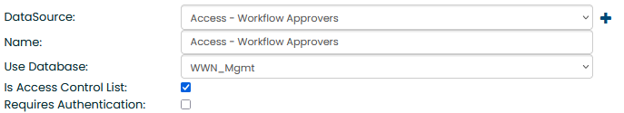
Access Datasource: Workflow Approvers
Tip: Name your datasource starting with access / lookup / options
select id_num from _wwn_myWWC_Forms_approvers
where approverType = 'manager’
union
-- The following selection includes our IT office all as forms managers.
select id_num from wwn_accounts where AD_groups like '%its office%' and recordstatus = 'C'
Notes:
We will be using this access control list to control who can access the portlet that’s used to manage the dynamic approvers.
We have a custom table in our environment where account status (and group memberships) is stored.
That custom table gets synchronized with our environment and gives easy DB access to things like Google Group membership and employee type.

Slide 13
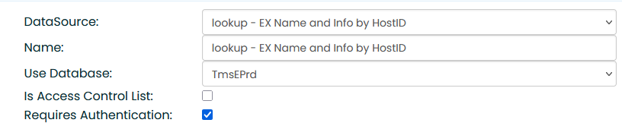
Lookup Datasource: Name and Info by HostID
Used for pre-filling forms with some common info. Requires Authentication
Will use a hidden on-form-load lookup query to populate other fields.
You can also make a bunch of string replacers for filling in data.
Notes:
This is a big honkin’ lookup that pulls our most common data needed on most forms.
Requires Authentication ensures that the lookup can only get executed from a logged in JICS session.
Careful about putting protected information (e.g. “legal name”) in a lookup.

Slide 14
Query for Lookup Datasource
You customize the fields and query you want to pull the data you need.
select
submitter_id = nm.id_num , jics_login = acct.jics_login,
campusName = nm.first_name, preferredName =nm.preferred_name,
lastName = nm.last_name, starEML = am_seml .addr_line_1,
cpo = cpo.addr_line_1, cpo_combo = cpo.addr_line_2
from
tmseprd.dbo.name_master nm
left join address_master am_emlp on am_emlp.id_num = nm.id_num
and am_emlp.addr_cde = 'EMLP'
left join address_master am_seml on am_seml .id_num = nm.id_num
and am_seml .addr_cde = '*EML'
left join address_master cpo on cpo.id_num = nm.id_num
and cpo.addr_cde = 'CPO’
where nm.id_num = @@LookUpValue
Notes:
Our lookup pulls custom names and email fields, and their CPO campus box number, and a few other details.

Slide 15
Let’s Set Up a Approvers Management Form using Approvers Managers system! whoa. meta.

Slide 16
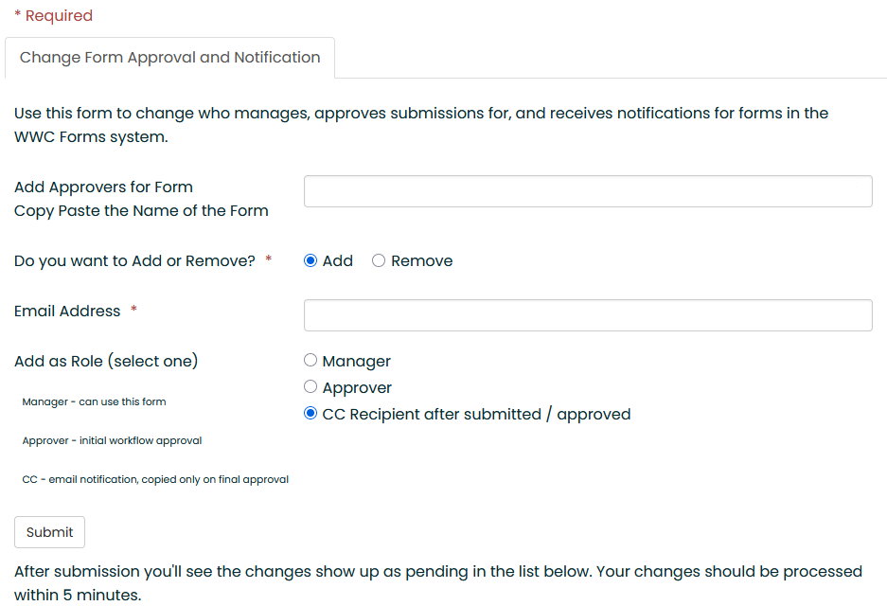

Approvers Management Form
Use this form
to manage the
_wwn_myWWC_Forms_approvers
table.
Notes:
Note that you can use rules to hide and show parts of this form.
The 5 min delay comes from the fact that the forms integration script runs every 5 mins
BUT...
if you want you could also use a stored procedure to do some of the stuff.
Especially in this case where it’s just database stuff happening.

Slide 17
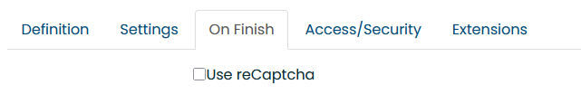
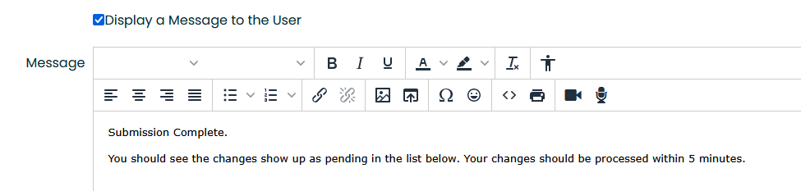
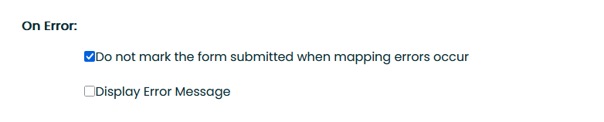
Form Settings
On Finish Settings

Slide 18
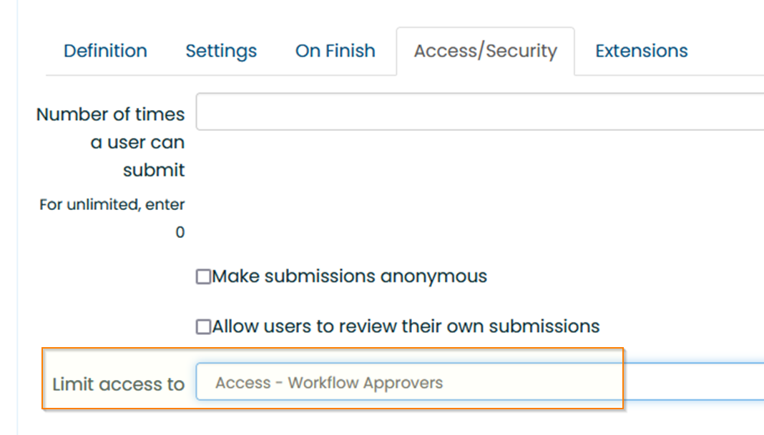
Form Access
Use that access list datasource we made

Slide 19
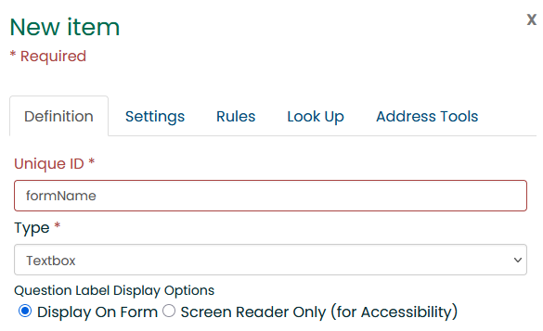
FormFlow – Flow as Usual!
Give the Unique ID a name that you will use later in the Mapped Statement. (coming soon!)
Notes:
Think carefully about your form element names

Slide 20
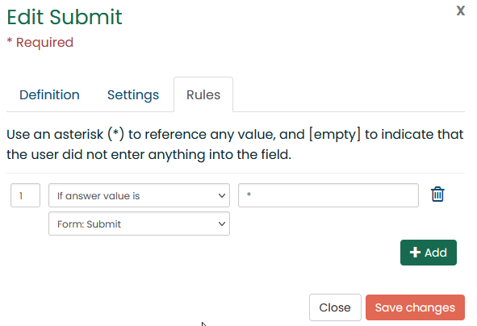

Other Fields are also usual FormFlow
The Submit button is just a simple Form: Submit action for forms that just need processing and notification.
Notes:
Keeping it simple!

Slide 21
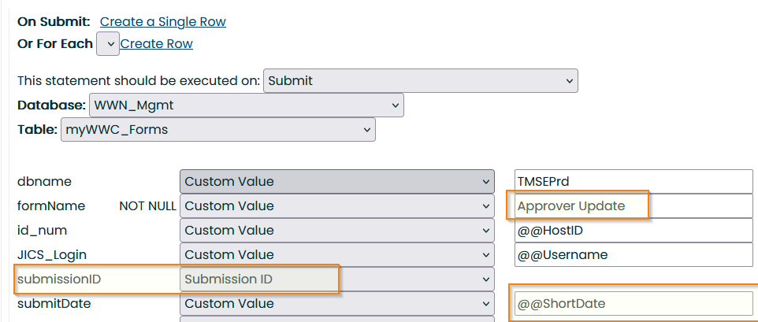
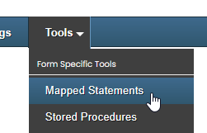
The Mapped Statement
The data goes from the form into the table via Mapped Statement
formName must exactly match what you will use in the script.
Elements highlighted should be as below.
Notes:
The Form Name can have spaces in it.
We will use the form name in the script.

Slide 22
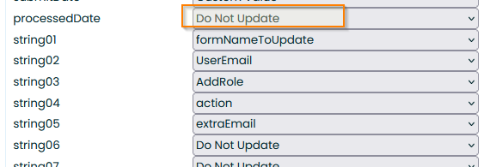
Mapped Statement Data
Don’t put data in the processedDate it will be used by the process script to see what’s new.
Load the data columns with Unique ID data from the form:
Notes:
If you were using a stored procedure
You would need to put that information somewhere in this table
to tell the script not to handle that form name.

Slide 23
Now…. Set up a Status Viewer for Approver / Notification Updates with SimpleQuery

Slide 24
A bit of SQL.
Current Records in the approvers table
select
'Current' as status, formName,
case
when approv.id_num is NULL then 'None'
when acct.email is NULL then approv.id_num
else acct.email
end as email,
approverType,
extraEmail
from _wwn_myWWC_Forms_approvers approv
left join your_email_lookup_view acct
on acct.id_num = approv.id_num
where approv.status = 'A’
UNION
Unprocessed Records in the forms data table
select
concat('Pending ', string04) as status,
string01 as formName,
string02 as email,
case
when string04 = 'Remove' then '--’
else string03
end as approverType,
-- for 'Remove’ approverType doesn't matter.
string05 as extraEmail
from wwn_mgmt..myWWC_Forms
where processedDate is NULL
and formname like '%approver update%'
Notes:
Just list out the current table
And list out any pending changes
Put them together with a union

Slide 25
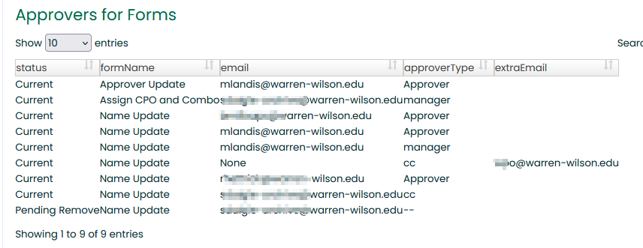

And pasting that into SimpleQuery
It isn’t very pretty, and you can make it pretty if you like!
But it gets the job done.
Notes:
Could add some spacing around the values for sure

Slide 26
Set Up the Processing Script

Slide 27

Wanna review a bunch of PowersHell code?
Great Gateway2000 No! … maybe.
I’ll show you some snippets and talk about the big ideas here.
Feel free to check out the Github Repo and dive in / paste it into AI or something.

Slide 28
What the Processing Does
Runs on a schedule. Like every 5 mins.
Pull out the rows from the data table where ProcessedDate is NULL
Unpack and extract the row into a hashtable / dict
Dynamically call a function to process the row
Collect error and status information
Invoke a procedure to notify everyone
Mark the row as processed by entering the date.

Slide 29
OMG Why?
Because…
On the processing / code side, we can do anything we want with that submitted data. Such as:
Invoke an API to shove it to an external system
Change group memberships in Google or Active Directory
Update other tables
Perform background operations and tasks (You can empower your users to invoke jobs you make)

Slide 30
Like this… Okay a bit of code then. And 3 peeks
$todo = get-unprocessedForms
write-host "wwc_forms $(count($todo)) submissions to process."
if (count($todo) -gt 0) {
start-transcript "$LogPath\wwc-forms.log" -Append
foreach ($f in $todo) {
try {
process-form $f
}
catch {
$formInfo = "Form Name: $($f.formName) sub_id: $($f.submissionID)"
write-host "ERROR in process forms! $_"
write-host $formInfo
write-host [string] $_.ScriptStackTrace
send-gmailMessage -To $errorEmail -Subject 'ERROR IN PROCESS FORMS! ’ -Body "Error: $formInfo"
}
send-queuedNotifications
stop-transcript
}
Notes:
the function that processes the form can queue up a bunch of notifications to send at the end.

Slide 31
get-unprocessedForms
Just a query to select the rows as a “list of dicts” (aka PSObjectArray) use whatever way you want to invoke and process a query.
function get-unprocessedForms{
param(
[Parameter(Position=0)] $forms = '%'
)
invoke-sqlquery -database 'wwn_mgmt' -As PSObjectArray -query "
select
campusName = nm.first_Name,
lastName = nm.last_Name,
email = eml.addr_line_1,
myWWC_Forms.*
from [wwn_mgmt].dbo.myWWC_Forms
left join [$ERPDatabase].dbo.name_master nm on nm.id_num = myWWC_forms.id_num
left join [$ERPDatabase].dbo.address_master eml
on eml.id_num = myWWC_forms.id_num and addr_cde = '*EML'
where processedDate is NULL order by submitDate
"
}
Notes:
Note that you can use a variety of tools to execute queries
We use “Windows Authentication”
A privileged service account runs the script from the task scheduler.

Slide 32

process-form
The incantation in purple builds the function name from the form name and calls it.
function process-form {
param( [Parameter(Position=0,mandatory=$true)] $formRecord )
# call the process function based on the name of the form (with spaces removed)
# These functions need to return some kind of information when they succeed.
# Or nothing (falsey) if they fail.Do a little validation
$err = "" if (!$formRecord.submissionID ) { $err += "submission ID missing; " }
if (!$formRecord.formName ) { $err += "formName missing; " }
if (!$formRecord.submitDate) { $err += "submit date missing;"}
if (!$formRecord.id_num) { $err += 'Submitter id_num missing'}
if (!$err) {
$funcName = 'process-' + ($formRecord.formName -replace ' ','')
try {
$result = (&($funcName) $formRecord)
} . . .
for our form this will invoke process-ApproverUpdate

Slide 33
send-queuedNotifications and notify-form
Here’s a snippet of that code, so you can get the idea…
The idea is to notify everyone in the approver table for that form.
$notifyR = invoke-sqlquery -database $ERPDb –sqlParameters @{form=$formName} -query "
select concat(string_agg(addr_line_1,';'), ';', string_agg(extraEmail,';')) as cc
from _wwn_myWWC_forms_approvers a
left join address_master am on am.id_num = a.id_num and am.addr_cde = '*eml'
where formName = @form "
# And clean it up. Only one email to hack out duplicates, and trim them out.
$CC = ''
foreach ($emailaddr in $ notifyR.cc -split ';') {
$emailaddr = $emailaddr.trim()
if ($emailaddr -and $emailaddr -notin $CC) {
$CC = $CC + $(if ($CC) {';'} else { ''}) + $emailaddr }
}
}
Notes:
We’re seeing how to get the email addresses to send to.
Not visible here is the actual sending of the email.
In our implementation, each form queues the messages that need sending.

Slide 34
ApproverUpdate in the Process Script
Here is the head of process-ApproverUpdate.
Wow the function name exactly matches the formName (wo space)
Yank the data out of the formRecord and do cool stuff.
function process-ApproverUpdate {
param( [Parameter(Position=0,mandatory=$true)] $formRecord )
# trimming is important. The form data may have a lot of extra S P A C E.
write-host "About to process-ApproverUpdate params"
$r = @{
id_num = [string]($formRecord.id_num) # submitter ID_num. may not be a manager.
formName = $(if (!$formRecord.string01) {''} else {($formRecord.string01).trim() })
userEmail = $(if (!$formRecord.string02) {''} else {($formRecord.string02).trim() })
approverType = $(if (!$formRecord.string03) {''} else {($formRecord.string03).trim() })
action = $(if (!$formRecord.string04) {''} else {($formRecord.string04).trim() })
extraEmail = $(if (!$formRecord.string05) {''} else {($formRecord.string05).trim() })
}
Notes:
Pull the data out of the form record
Use some validation and clean it up
Our JICS version pads the values with spaces to whatever the form length is, for some reason

Slide 35
Now with FF-Workflows! and Lookups!

Slide 36
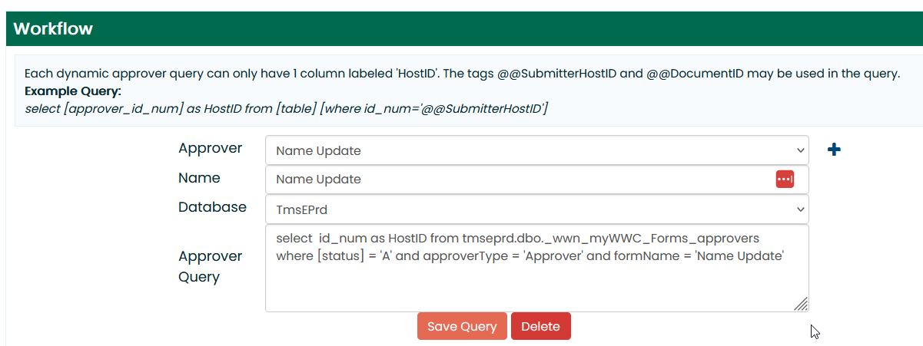
Use Forms_approvers table for dynamic approval.
You can then have staff manage the approvers directly.
Notes:
We have a name update form, so students can update their campus name and first name.
The changes require an approval process
to prevent weird names like “Yosemite Sam”

Slide 37
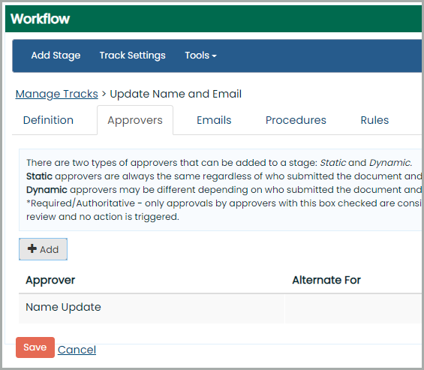
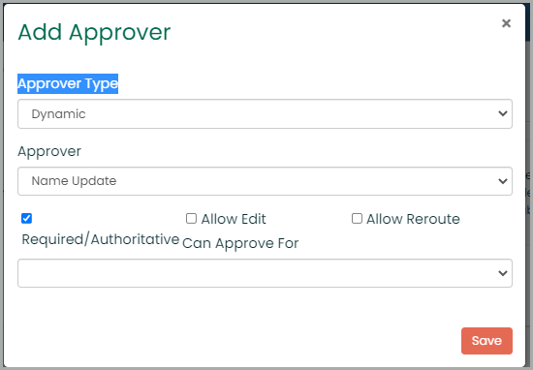
Add your Dynamic Approver Track
The dynamic approver is a dedicated query. But at least you don’t have to keep changing the workflows. It’s all in one table.
Notes:
You can add approvers to forms without having to make changes to the workflows
A change in approver does not change who approves existing submissions.

Slide 38
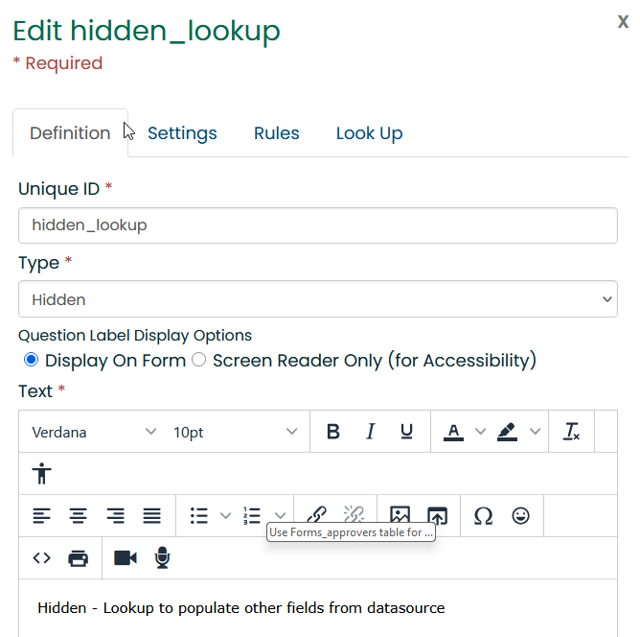
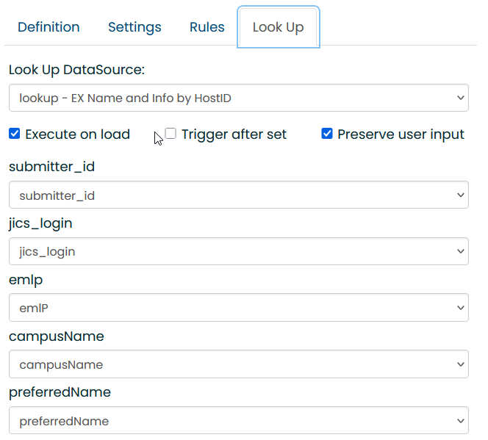
Using a Lookup in a Form
The Lookups can pre-populate the form with live data.
This is pretty standard “FormFlow” but really useful for CRUD in this context
Notes:
We use that one big honkin’ lookup to prepopulate our forms
Put the lookup in a hidden field.
Execute on load makes it trigger.
Then you can route the data to other FormFlow fields.

Slide 39
Adding to the forms script
Standard $formRecord. From that table!
Trimming the data.
Default values
Name of form matches mapped statement value
function process-NameUpdate {
param(
[Parameter(Position=0,mandatory=$true)] $formRecord
)
write-verbose " Getting user $($r.id_num)"
$u = get-user $formRecord.id_num -content 'google;ad;ex'
# Form data may have a lot of extra SPACE___. So trim.
# But you can't trim a NULL. So be careful with that!
$r = @{
id_num = [string]($formRecord.id_num)
cname = $(if ($formRecord.string01) {($formRecord.string01).trim()} else {$u.ex_first_name})
pname = $(if ($formRecord.string02) {($formRecord.string02).trim()} else {$u.ex_preferred_name})
emlp = $(if ($formRecord.string03) {($formRecord.string03).trim()} else {$ex_emlp})
}
Notes:
All you gotta do is define this one function. All the other scaffolding and tools are there.
“get-user” is a script in our environment to load a lot of account details about a user.

Slide 40
Looking Forward!

Slide 41

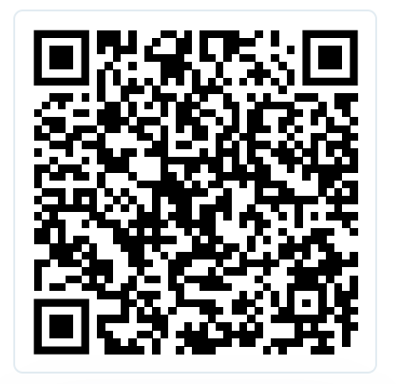
More Fun Things to Do… Questions?
Build out use of ICS_NET tables instead of a data table
Explore other features of FormFlow and JWorkFlow
Maybe python!
Github Repo:
Presentation – Check the Github for latest update!
Notes and documentation
Code
SQL tables and views
https://github.com/mars-wilson/jam2025_forms
mlandis@warren-wilson.edu
Say byebye to Sammy!

Slide 42
Security Concerns
Store credentials and API secrets in the windows credential manager.
Write some tools to help manage those credentials for your service acct.
Code-Sign your production scripts, and re-sign them when moving from dev into production.
You can use a custom PS script to check your python scripts against changes before invoking python. (Sign them, store a checksum in your database, etc.)

Slide 43
Views: Who can do What with Which Form
Here is a quick select of people names and what they can do:
select id, formName, fa.id_num, approverType, extraEmail, [status],
nm.last_name, nm.first_name
from wwn_myWWC_forms_approvers fa
left join [tmseprd].dbo.name_master nm on nm.id_num = fa.id_num

Slide 44
Move along now…
Thankyouverymuch.

